Slide 1

Book Recommendation Chatbot
Using IBM Watson Assistant
Name: Raj Gupta
Roll no.: 2300100100296
Institute: United College of Engineering and Research

Slide 2
Introduction
Developing a chatbot for book recommendations. Leverages IBM Watson Assistant for natural language interaction. Suggests books based on user-selected genres.

Slide 3




Project Objectives
Virtual Assistant Development
Genre-Based Recommendations
Enhanced User Interaction
Utilize Natural Language Processing (NLP).
To build an interactive chatbot.
Suggest books by user preferences.

Slide 4




Tools and Technologies
IBM Watson Assistant
Cloud Services
Core platform for chatbot development.
Deployment and hosting infrastructure.
JSON for Data
Python
Structuring intents and entities.
For potential integration scripts.

Slide 5




Workflow Diagram
User Input
Watson Processing
Message sent to chatbot.
Identifies user intent.
Book Suggestion
Conversation Flow
Provides genre-based recommendations.
Continues or ends based on user.

Slide 6

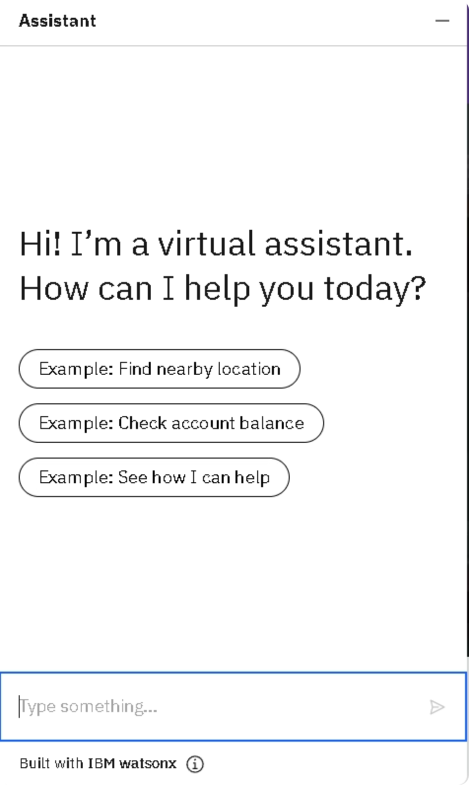

Example Conversation
User Input
Watson Processing
Conversation Flow
Book Suggestion

Slide 7
Project Results
Functional Chatbot
Multi-Genre Support
Seamless Interaction
Successfully built and tested on IBM Watson.
Handles various book genres effectively.
Well-designed intents and entities.

Slide 8

Conclusion
This chatbot highlights the power of AI and IBM Watson Assistant. Simplifies user experience for book recommendations. Achieved through natural language conversation and genre-based suggestions.

Slide 9
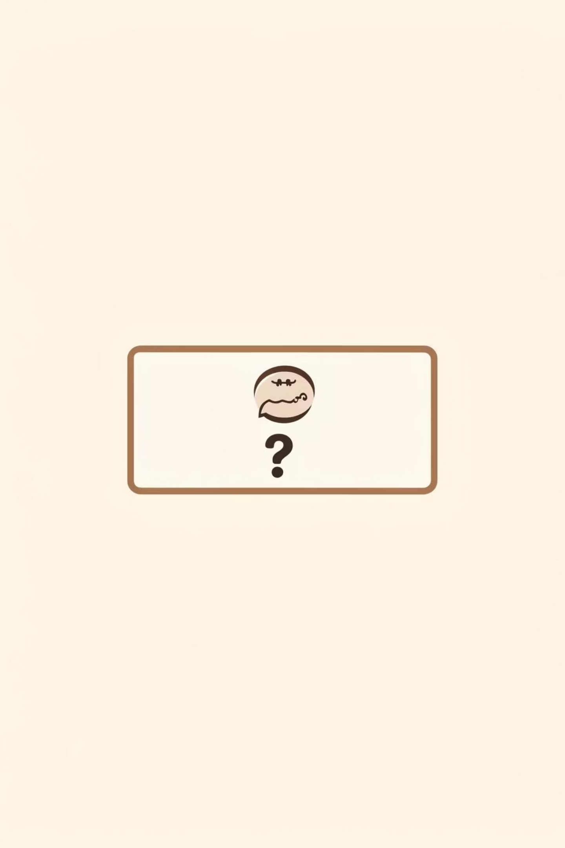
Thank You!

